Slide 1
Agentic AI
-QFC’25
-Darshana Anandi

Slide 2
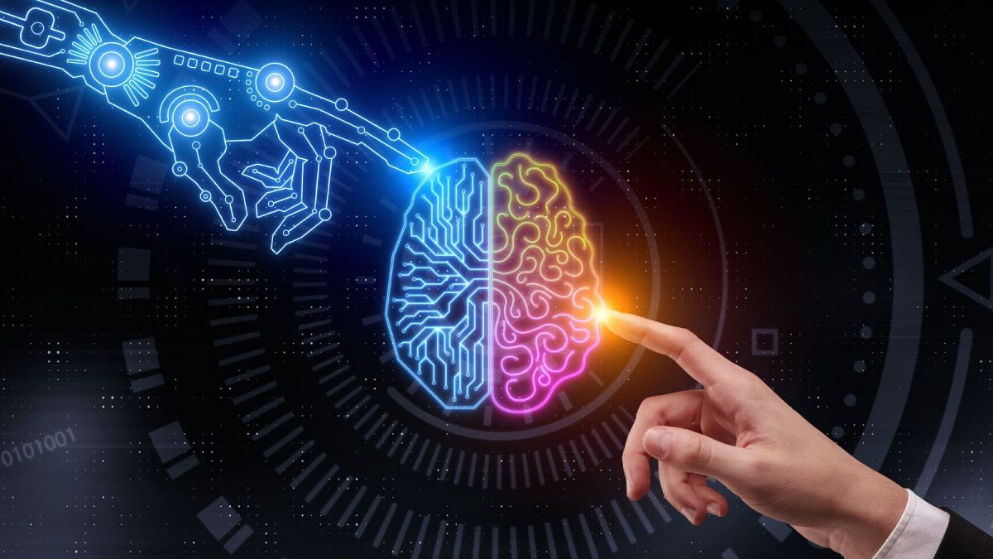
What comes to your mind when you see this picture?

Slide 3
Artificial intelligence is a field of science concerned with building computers and machines that can reason, learn, and act in such a way that would normally require human intelligence or that involves data whose scale exceeds what humans can analyze.
What is Artificial Intelligence (AI)?

Slide 4
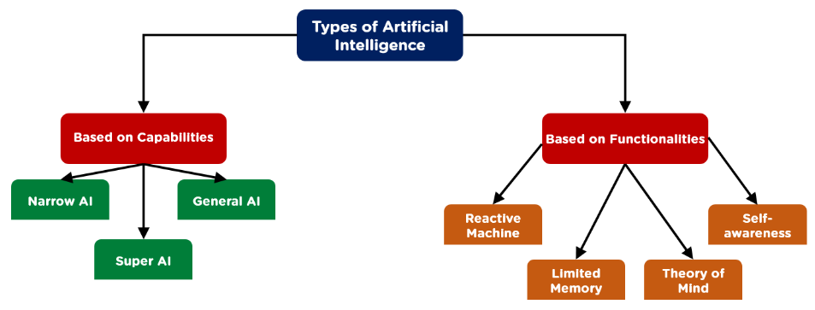
Types of AI

Slide 5
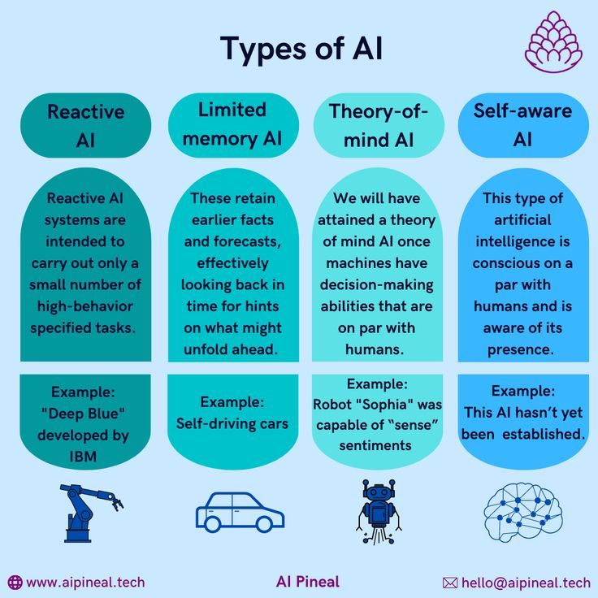
Types of AI (Based on Functionality)
Examples
Reactive – Deep Blue Playing Chess.
Limited Memory – Self Driving Cars Learning from past data.
Theory of Mind – Robots learning human emotions.
Self-aware – Machines making their own decisions (bypassing human intelligence.

Slide 6
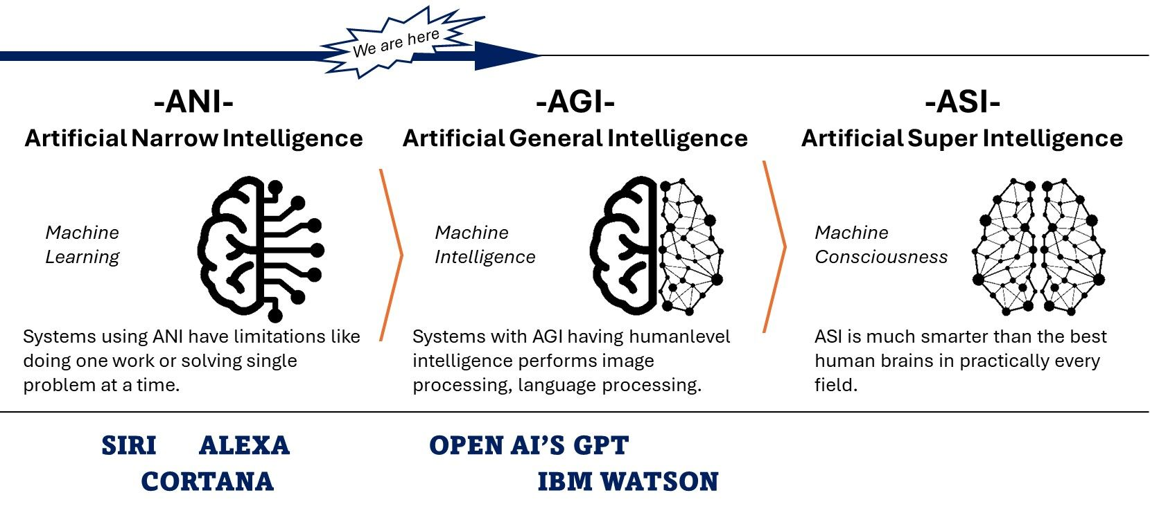
Types of AI (Based on Capabilities)

Slide 7
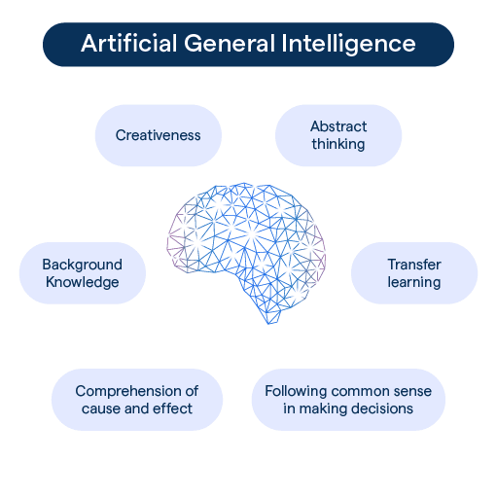
Artificial General Intelligence (Formally)
AGI refers to a hypothetical type of AI that possesses human-like cognitive abilities across a wide range of tasks.
Essentially, an AGI would have the versatility and adaptability of human intelligence.
Currently, true AGI - DOES NOT exist.

Slide 8
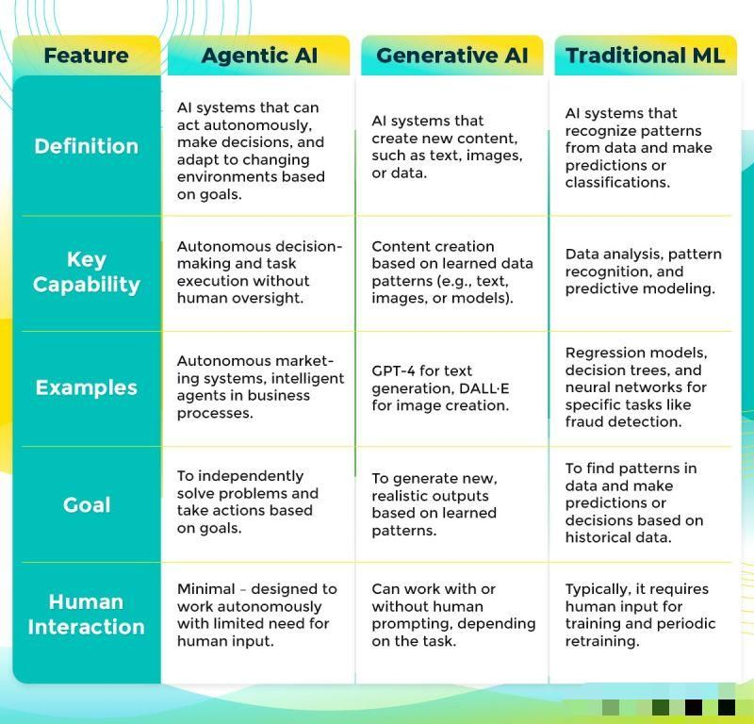
(Future To Be) Components of AGI
Why “Future To Be”?
Agentic AI and Gen AI may contribute as components of AGI in future.
Today, they are different concepts under AI.
In some ways, Gen AI serves as a component of Agentic AI, providing capabilities to communicate, explain, or create content as part of a larger goal-driven process

Slide 9
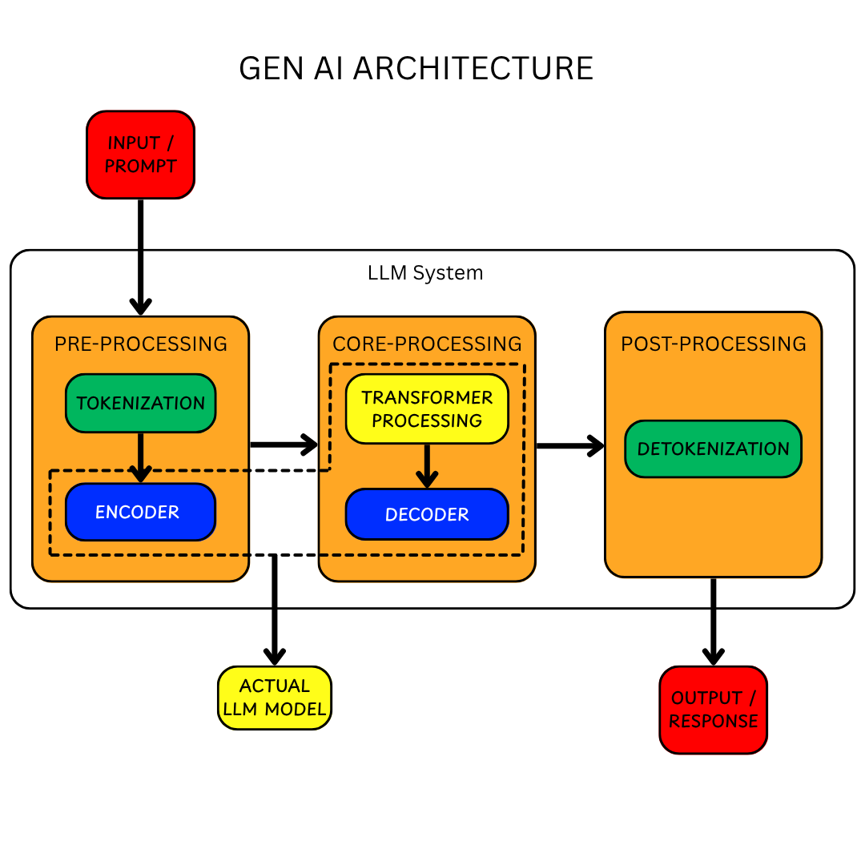
Architecture of GenAI

Slide 10
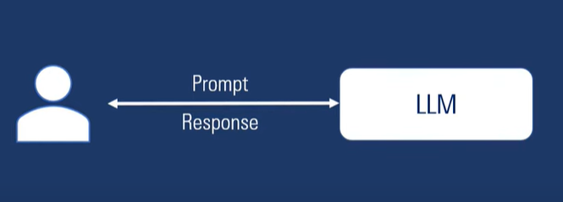
Source: https://www.youtube.com/watch?v=FEU6-Il8jjw
Why Do We Need AI Agents?
Before going into Agentic AI Architecture - Lets first understand why do we need AI Agents?
LLM alone cannot perform actions or get things done.
They only respond to what we ask & their knowledge is also limited to the data they are trained on.
Solution?

Slide 11
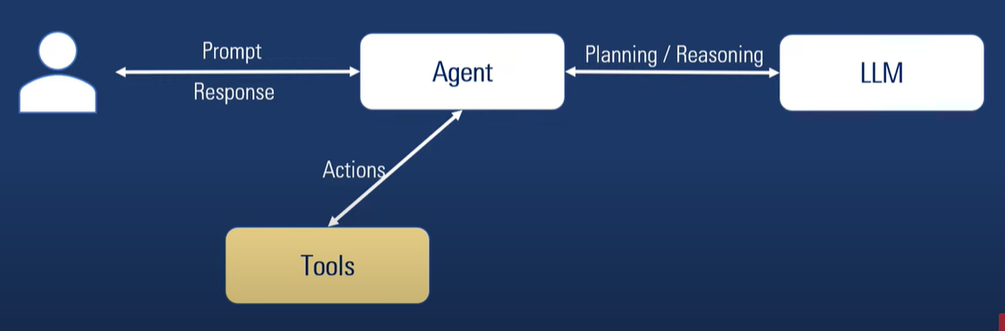
Source: https://www.youtube.com/watch?v=FEU6-Il8jjw
Why Do We Need AI Agents?
Let’s add an agent in between and provide agent with access to some tools to perform a task.
Tools (like calendar, database, zoom, weather API, etc) can perform actions.
LLM can do planning and reasoning.
But how will Agent remember things ?

Slide 12
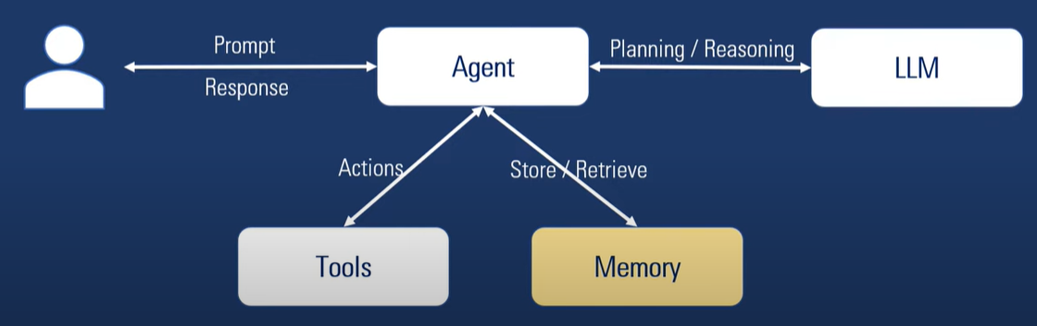
Source: https://www.youtube.com/watch?v=FEU6-Il8jjw
Why Do We Need AI Agents?
For Agents to remember things, lets add memory.
Both Short-term and Long-term memory can be used here.
Fine, but how to tell the agent what we want to achieve?

Slide 13
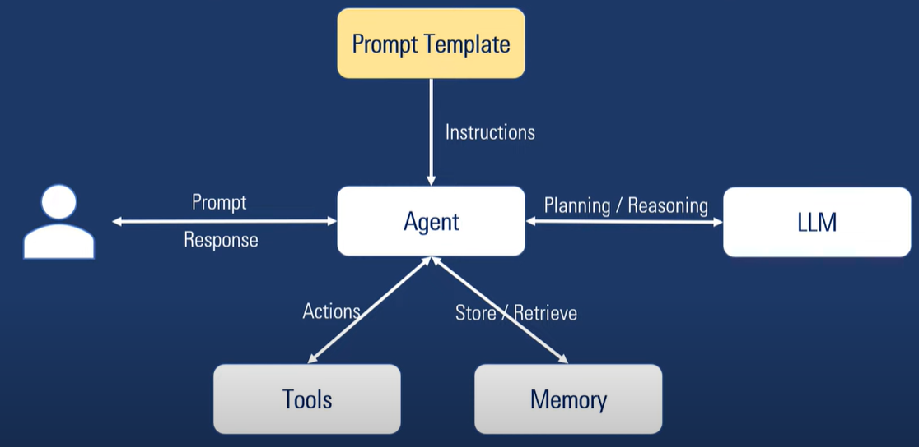
Source: https://www.youtube.com/watch?v=FEU6-Il8jjw
Why Do We Need AI Agents? - AI Agent Architecture
Prompt Template is a way to give instructions to the Agent.
Example: You are a friendly agent that answers questions about Dates and Weather
Once the agent has instructions on how to act and what to do, user can use Prompts to interact with agent, ask questions and get info.
This sums up as an AI Agent Architecture.

Slide 14
Source: https://www.youtube.com/watch?v=FEU6-Il8jjw
What Are AI Agents?
AI Agent is a system (Software Entity), that can –
Perceive its environment (Receive inputs)
Collect Data
Make Decisions
Take Actions
To receive inputs, Text prompts are not the only way - any Sensors such as camera, microphone etc can be used.
Agents need –
Prompt Template – to give them clear instructions on their purpose, and how we want to see the results.
LLM – To perform planning and reasoning
Tools – Access to tools so they can perform actions
Memory – For agents to remember things.

Slide 15
Source: https://www.youtube.com/watch?v=FEU6-Il8jjw
What Are NOT AI Agents?
Applications that integrate LLMs but don’t use them to control workflow execution—think simple chat bots, single-turn LLMs, or sentiment classifiers—are not agents
Simple Comparison
Non-agentic: I say, “Write a report,” and the AI outputs it immediately.
Agentic: The AI outlines the report, researches relevant sources, revises drafts, and improves the final work, with internal feedback loops.

Slide 16
Source: https://www.youtube.com/watch?v=FEU6-Il8jjw
WHEN to build an agent?
Unlike conventional automation, agents are uniquely suited to workflows where traditional deterministic and rule-based approaches fall short.
So, prioritize workflows that have previously resisted automation, especially where traditional methods encounter friction.
Consider the example of payment fraud analysis.
A traditional rules engine works like a checklist, flagging transactions based on preset criteria.
In contrast, an LLM agent functions more like a seasoned investigator, evaluating context, considering subtle patterns, and identifying suspicious activity even when clear-cut rules aren’t violated.
This nuanced reasoning capability is exactly what enables agents to manage complex, ambiguous situations effectively.

Slide 17
Source: https://www.youtube.com/watch?v=FEU6-Il8jjw
Criteria for building an agent
Complex decision-making: Workflows involving nuanced judgment, exceptions, or context-sensitive decisions, for example refund approval in customer service workflows.
Difficult-to-maintain rules: Systems that have become unwieldy due to extensive and intricate rulesets, making updates costly or error-prone, for example performing vendor security reviews.
Heavy reliance on unstructured data: Scenarios that involve interpreting natural language, extracting meaning from documents, or interacting with users conversationally, for example processing a home insurance claim.

Slide 18
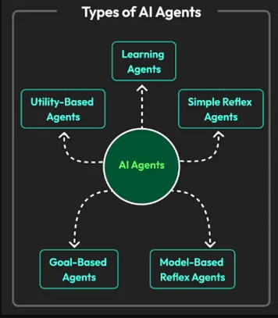
Source: https://medium.com/%40anil.jain.baba/agentic-ai-architectures-and-design-patterns-288ac589179a
Types of AI Agents
Simple Reflex Agents: Act based on simple condition-action rules. They only consider the current state of the environment and don't maintain any memory or history. Example: A robot vacuum cleaner that moves forward until it detects an obstacle and then changes direction.
Model-Based Reflex Agents: Maintain an internal model of the world that they update based on their observations. This allows them to make more informed decisions than simple reflex agents. Example: A robot navigating a maze. It might use a map (its internal model) to plan a path to the exit and update the map as it explores the maze.
Goal-Based Agents: Have specific goals they are trying to achieve. They plan their actions to reach these goals, taking into account the possible consequences of their actions. Example: A self-driving car with the goal of reaching a specific destination, considering traffic, road conditions, and other factors to choose the best route and make decisions about speed and lane changes.
Utility Based Agents: Have a utility function that quantifies the desirability of different states. They choose actions that maximize their expected utility. Example: A stock trading agent that aims to maximize its profits. It might consider factors like current stock prices, predicted future prices, and the agent's risk tolerance when deciding which stocks to buy and sell.
Learning Agents: Improve their performance over time by learning from their experiences. They can adapt to changing environments and improve their decision-making based on past actions and feedback. Example: A spam filter that learns to identify spam emails based on user feedback (e.g., marking emails as spam or not spam).

Slide 19
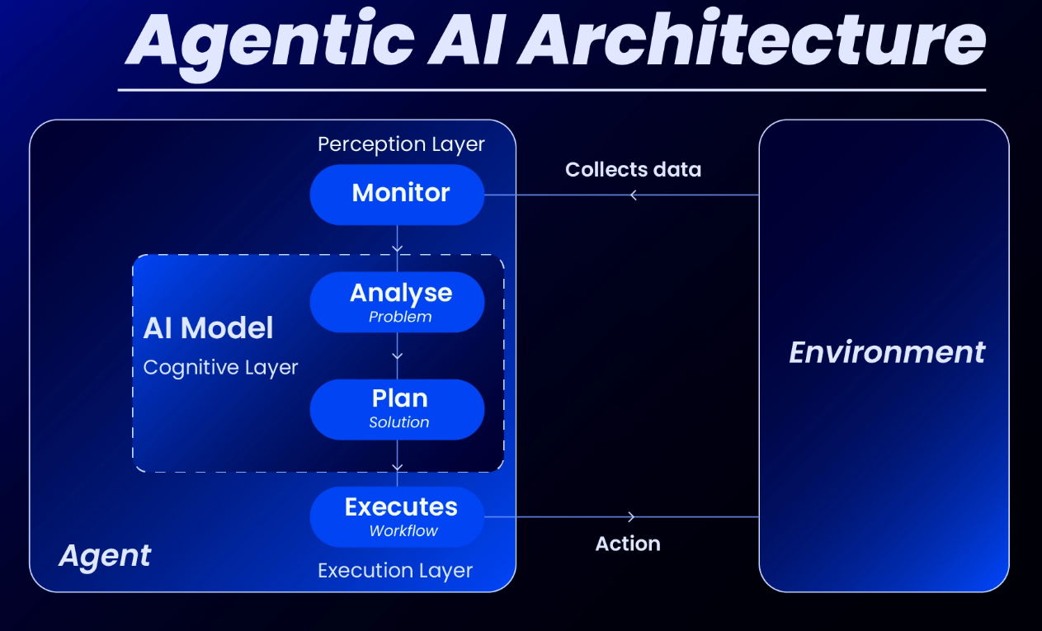
Architecture of Agentic AI
Agentic AI are AI Systems or framework that enables AI Agents to act autonomously (no human intervention required), on workflows, to plan, make decisions and adapt to their changing environments based on their goals (Goal Directed Behavior).
Workflows: A workflow is a sequence of steps that must be executed to meet the user’s goal, whether that's resolving a customer service issue, booking a restaurant reservation, committing a code change, posting on linkedIn / Instagram or generating a report.
Workflows can exist independently of specific AI technologies like LLMs or agents, representing a structured sequence of actions. However, they often incorporate AI technologies to enhance their capabilities.
Workflows, in the context of AI, are not just part of one specific type (LLM, Agent, etc.), but are a fundamental component of how AI systems, including LLMs, AI agents, and agentic AI, operate and execute tasks.

Slide 20
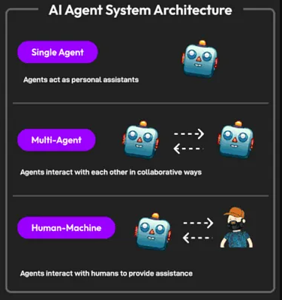
Source: https://medium.com/%40anil.jain.baba/agentic-ai-architectures-and-design-patterns-288ac589179a
AI Agents Systems
Single Agent: A single-agent AI system operates independently to accomplish specific tasks, using its own logic and models without needing input or collaboration from other agents. They excel at focused, well-defined problems. Examples:
Spam Filters, Smart Thermostats (basic), Fraud Detection (rule-based), Resume Screening Software, Chess-Playing Programs (early versions).
Multi-Agent: A multi-agent system (MAS) consists of multiple intelligent agents that interact, communicate, and coordinate to achieve a shared objective or solve complex problems. Each agent may have specialized capabilities. Examples:
Smart Traffic Management Systems, Collaborative Warehouse Robotics, Disaster Response Simulations, Automated Trading Systems, Healthcare Patient Flow Management.
Human-Machine: Human-machine collaboration involves a synergistic partnership between humans and AI systems, leveraging the unique strengths of both to achieve superior outcomes than either could alone. Examples: AI-Assisted Medical Diagnosis, Generative AI in Creative Industries, Collaborative Robots (Cobots) in Manufacturing,
Financial Trading with AI Insights, Customer Service with AI Chatbots and Human Agents.

Slide 21
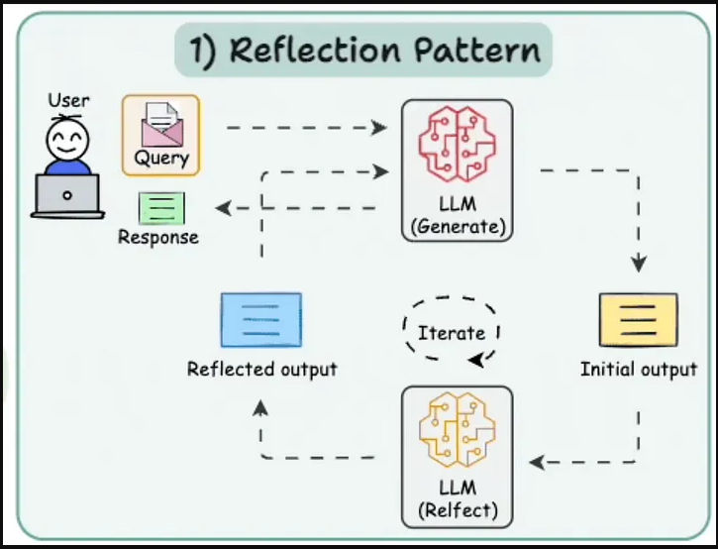
Source: https://medium.com/%40anil.jain.baba/agentic-ai-architectures-and-design-patterns-288ac589179a
Design Patterns in Agentic AI Systems – Reflection
The Reflection Pattern lets an AI review its own work to find mistakes and improve. It’s like an AI checking its essay for errors before submitting.
This helps the AI get better over time, reducing errors in tasks like writing code or creating content, which is crucial for reliability.

Slide 22
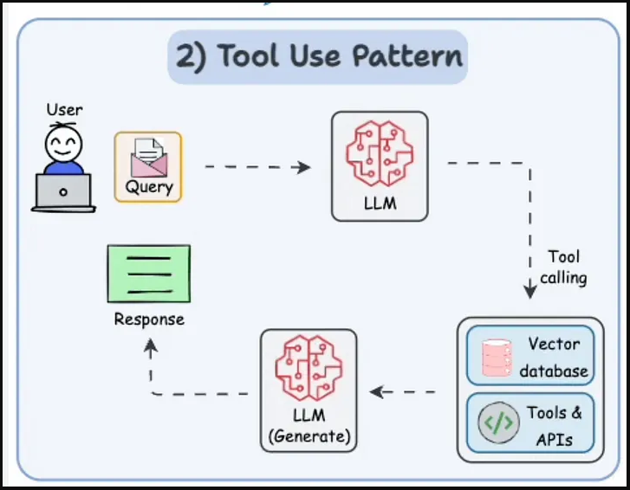
Source: https://medium.com/%40anil.jain.baba/agentic-ai-architectures-and-design-patterns-288ac589179a
Design Patterns in Agentic AI Systems – Tool Use
The Tool Use Pattern lets the AI use external tools, like web search or APIs, to get information or do tasks it can’t do on its own.
This makes the AI more versatile, letting it handle real-world tasks like finding facts online or doing math, which it couldn’t do just from memory.

Slide 23
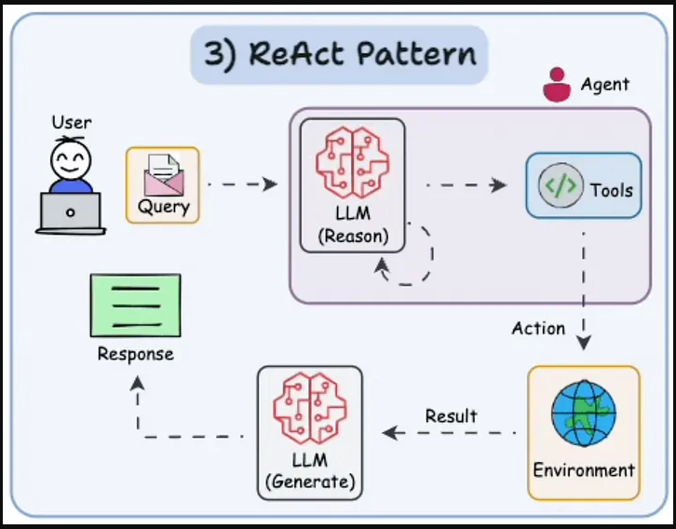
Source: https://medium.com/%40anil.jain.baba/agentic-ai-architectures-and-design-patterns-288ac589179a
Design Patterns in Agentic AI Systems - ReAct
The ReAct Pattern, or “Reason and Act,” means the AI thinks through a problem step by step and then takes actions, like using tools, based on that thinking. It’s like planning and doing at the same time.
This helps the AI solve tricky problems by combining thinking and doing, making it more dynamic and able to handle tasks that need both, like answering multi-part questions.

Slide 24
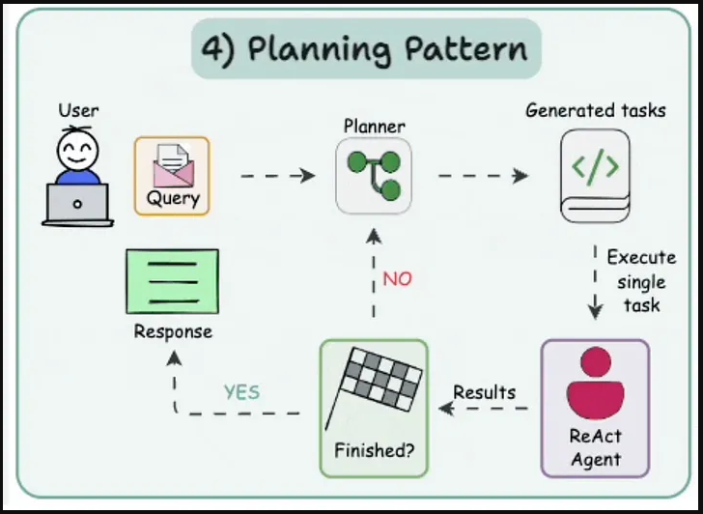
Source: https://medium.com/%40anil.jain.baba/agentic-ai-architectures-and-design-patterns-288ac589179a
Design Patterns in Agentic AI Systems - Planning
The Planning Pattern means the AI breaks down big tasks into smaller steps and makes a plan to tackle them, like outlining a project before starting.
This is key for complex tasks, ensuring the AI organizes work into manageable parts, making it efficient for long-term goals like planning a trip or diagnosing a patient.

Slide 25
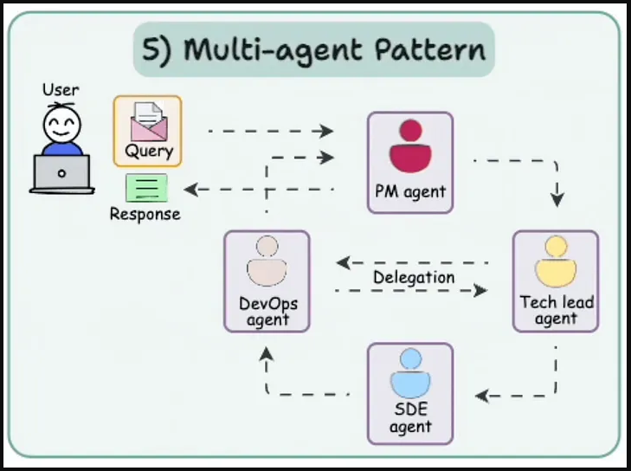
Source: https://medium.com/%40anil.jain.baba/agentic-ai-architectures-and-design-patterns-288ac589179a
Design Patterns in Agentic AI Systems – Multi-Agent
The Multi-Agent Collaboration Pattern means several AI agents work together, each with a specific role, like a team where one plans, one codes, and one checks the work.
This is great for big projects, letting agents specialize and collaborate, making the system more robust for tasks like software development or customer support.

Slide 26
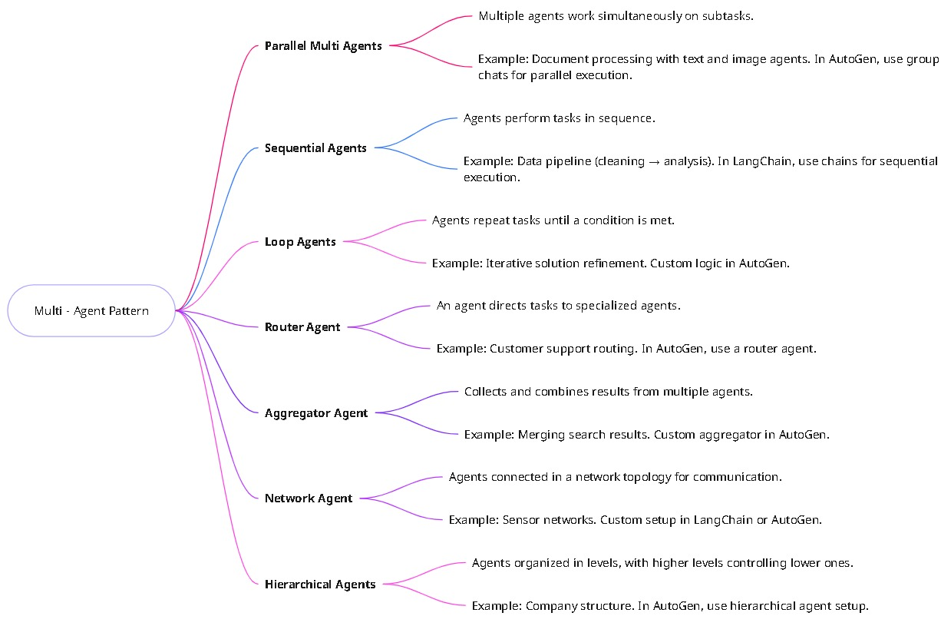
Source: https://medium.com/%40anil.jain.baba/agentic-ai-architectures-and-design-patterns-288ac589179a
Design Patterns in Agentic AI Systems – Multi-Agent Sub categories

Slide 27
Example of Agentic AI System in Jupyter

Slide 28


Slide 29


